Slide 1
Working with Arrays in React Components

Slide 2
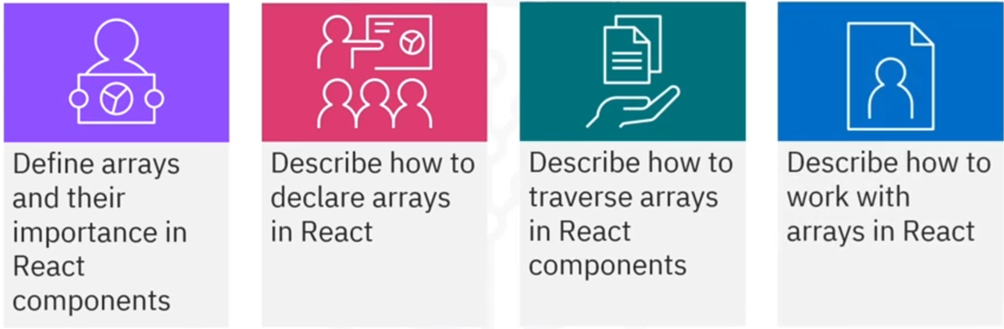
What you will learn

Slide 3
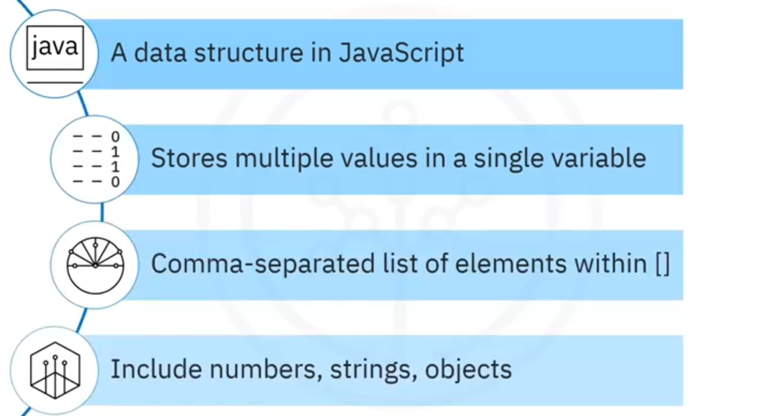
Defining an array

Slide 4
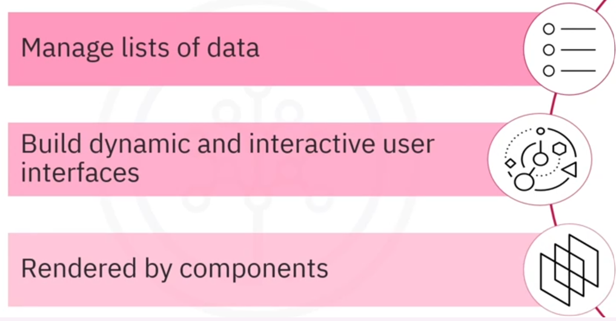
Arrays in React

Slide 5
Array literal

Slide 6
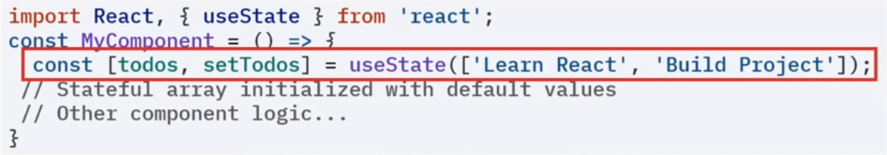
Stateful array

Slide 7
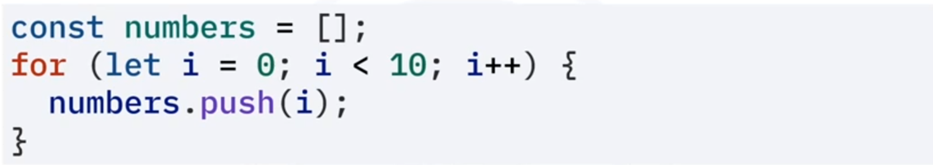
Dynamically constructed arrays

Slide 8
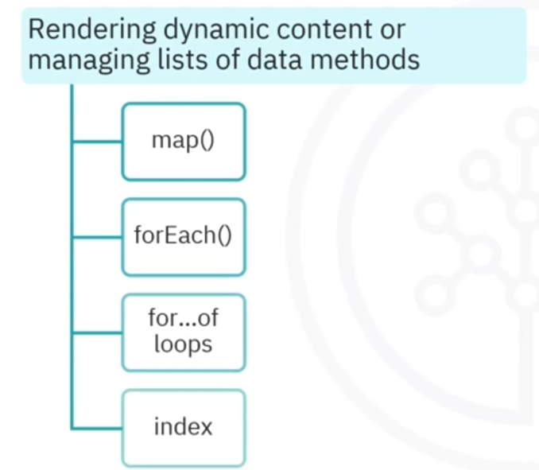
Traversing arrays in React components

Slide 9
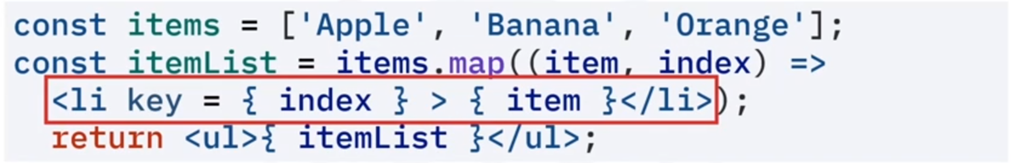
map() method

Slide 10
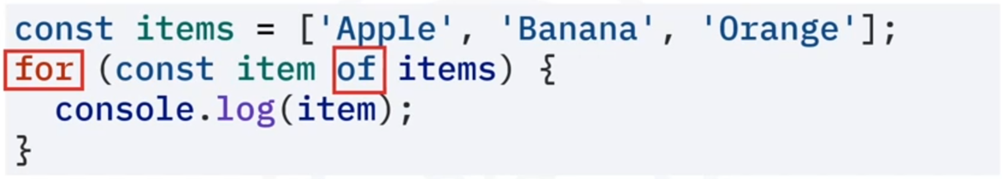
For…of loop

Slide 11
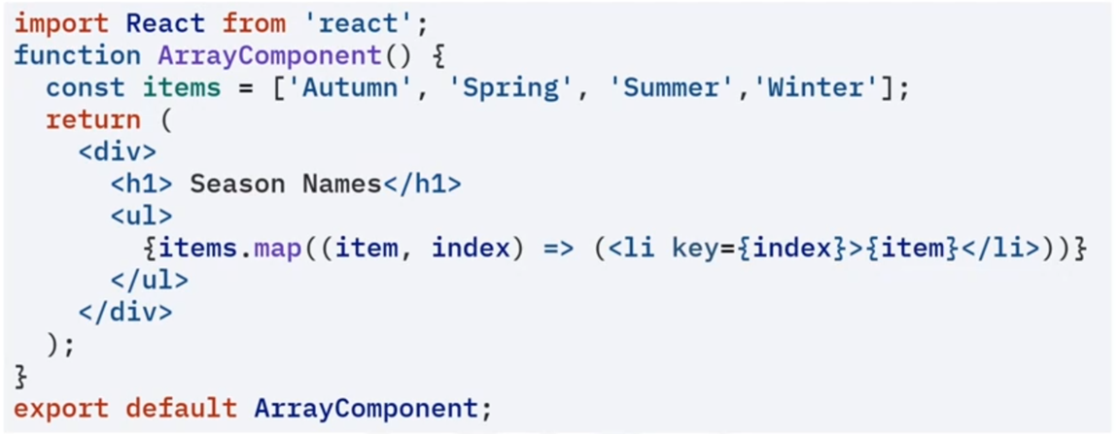
Render a list

Slide 12
Output
Season Names
Autumn
Spring
Summer
Winter
Remove
Remove
Remove
Remove

Slide 13
Add/remove output
Season Names
Autumn
Spring
Summer
Winter
Monsoon
Remove
Remove
Remove
Remove
Remove
Add

Slide 14
Recap
In this lesson, you learned that:
• Arrays are basic data structures that are often used to store
groups of items in a single variable
• Some important array methods are map() and forEach()
• Methods such as push(), and splice() can be used to add and
remove elements
• Arrays are a powerful data structure for quickly changing and
traversing data

